Slide 1
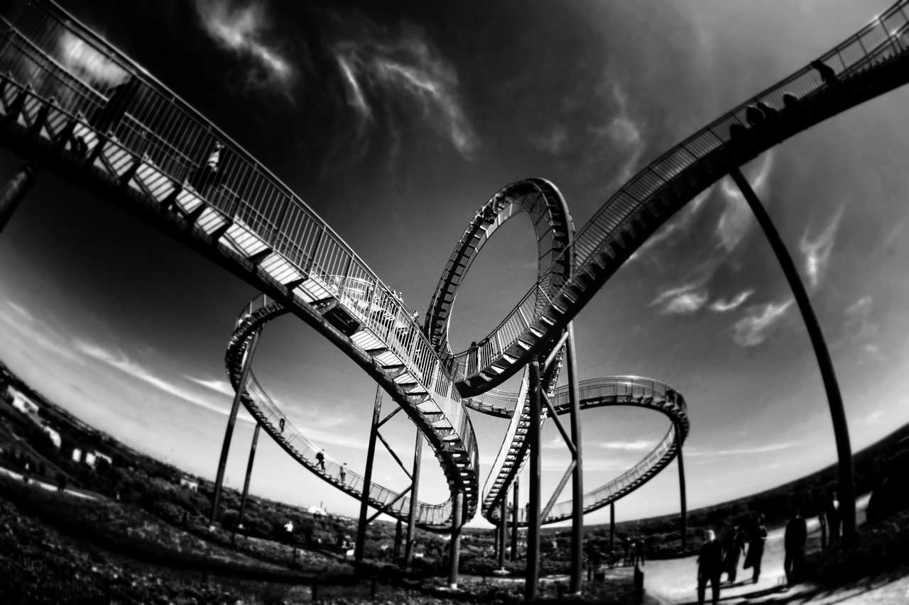
Grantham Property Market
… the Rollercoaster of the last Decade

Slide 2
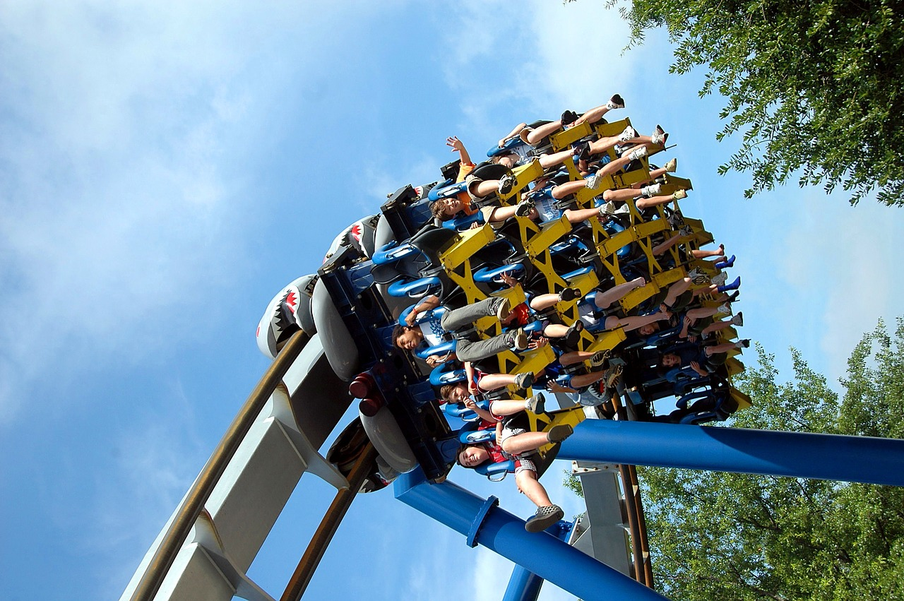
Grantham Property Market
The Rollercoaster of
the last Decade

